Slide 1
Repeatable Registration Processes
Populating Data to MIMOSA Registry
Dr. Xinxin Wang
Supporting CECOM SEC
wang_xinxin@bah.com
CBM+ File and Message Workshop
June 12-14, 2012

Slide 2
Objectives and Assumptions
Objectives
Leverage previous registration work done by TACOM and LOGSA as much as possible
Resolve issues found during CECOM’s work on populating data to MIMOSA registry
Define criteria used to determine which objects to add to the CBM+ registry
Define repeatable registration processes that can be applied to all CECOM scenarios
Assumptions
Focus on the hard assets (e.g. platforms and equipment) of the Army
Focus on adding/updating CBM objects

Slide 3
Used Terms
Asset – An item that has value to be tracked for CBM (e.g. platform, valuable Replaceable Unit or sensor)
Platform – A system (end item) of which the health condition needs to be monitored and assessed as a whole
Replaceable Unit (RU) – A stock item that can be installed on one or multiple platforms and replaced with another RU of the same model
Model – A class of asset that has the same component tree structure
Assembly - A component in a model component tree that is not an RU and has subcomponents
Part – A subcomponent in a model component tree that is not an RU and has no subcomponent
Source Maintenance and Recoverability (SMR) Code – A 5-letter code assigned to each component in an Interactive Electronic Technical Manual (IETM): first 2 letters are source code, 3rd and 4th letters are maintenance code and the 5th letter is the recoverability code

Slide 4
Used Terms (continued)
Segment – A MIMOSA object that represents a component in a component tree of an asset or a model. A segment for an asset is called an Instance Segment and a segment for a model is called a Prototype Segment.
Measurement Location – A MIMOSA object that represents a CBM measurement (e.g. sensor signal or status assessment) for an asset or a model. A measurement location for an asset is called an Instance Measurement Location and a measurement location for a model is called a Prototype Measurement Location.
Site – A container that groups MIMOSA objects (e.g. segments and measurement locations) for an asset or a model. A site for an asset is called an instance site and a site for a model is called a prototype site.

Slide 5
Registration Processes
Model Registration Process
Add/Update models and their associated prototype component trees for platforms and RUs
Measurement Configuration Process
Add/Update prototype measurement locations for a model or instance measurement locations for an asset*
Asset Registration Process
Add/Update platforms, valuable RUs or other serialized items
Replaceable Unit Installation Process
Install RU assets on target segments of parent assets
*The process currently doesn’t handle custom instance measurement configuration for an asset. If we need to support custom measurement locations for each individual platform or even RU, the process will be updated to handle Instance measurement Configuration as well.

Slide 6
Model Registration Criteria
Model – Identified by NIIN or CAGE/PartNo and for:
Platform: Determined by MACOM
RU asset (stock and replaceable item) - SMR source code is: PA, PB, PC, PG or PH
Model Prototype Component Tree* – Derived from Interactive Electronic Technical Manuals (or Bill of Materials?); candidate components in the tree are:
A monitored component (RU, assembly, or part)
An RU or assembly that contains a candidate component
Each component in the tree:
Includes Name (mandatory), SMR code, NIIN, CAGE/PartNo
Has a Unique Composite Key for each component under an assembly: Name, NIIN, CAGE/PartNo
Site – Each model has a site for its prototype components
*Another option is to derive a model component tree from a Bill of Materials (MBOM, PBOM or RBOM?) with the assumption that BOMs already exist in relational form in the LMP (Logistics Modernization Program). There is an indicator of stock item and an indicator of recursive item (repairable item?) for each component in a BOM.

Slide 7
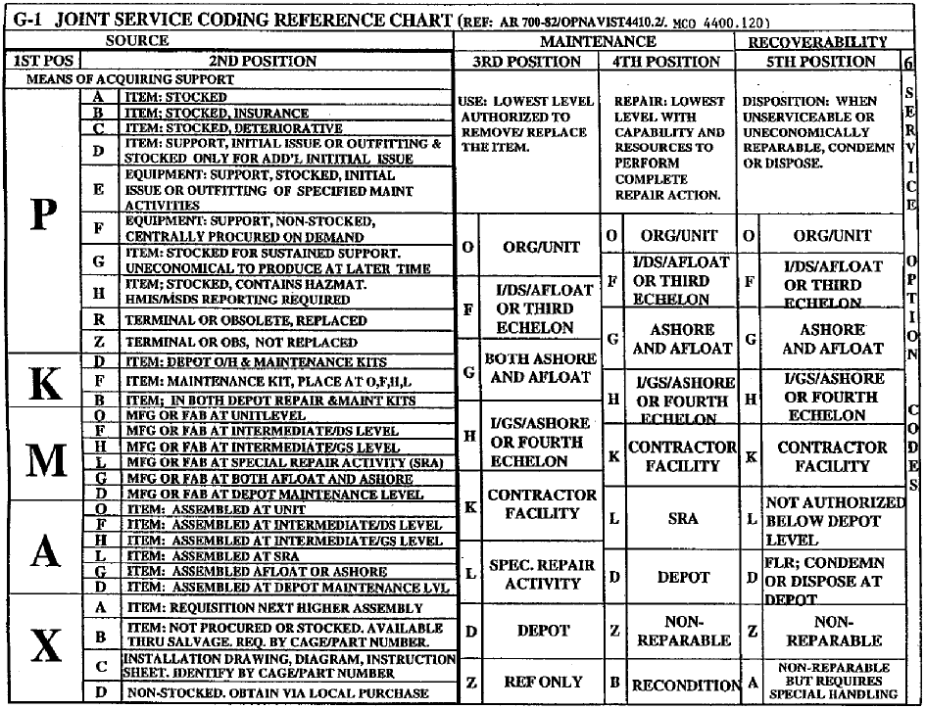
SMR Code

Slide 8
Hypothetical Models
Site M1
M1
M2
Site M2
M3
Site M3
M1:A1
M2:R3
M2:P1
M1:R1
M1:R2
M1:R1P1
M1:R1R3
M1:R2P1
M1:R2R3
M
Top component of the prototype tree of Model ‘M’
Component relationship
M:A
An assembly ‘A’ in the prototype tree of model ‘M’
Clone of a component relationship
M:R
An RU ‘R’ in the prototype tree of model ‘M’
Clone of a component from an inherited model
M:P
A part ‘P’ in the prototype tree of model ‘M’
Inheritance relationship
Note: Cloned subcomponents may not be needed if we make some assumptions for sensor configuration. Adding these components makes sensor configuration more flexible (more discussions later).

Slide 9
Models in Registry
Models added for platforms or valuable RUs only
Each model has a prototype site in site table
If a model doesn’t have a NIIN, but has CAGE/PartNo, a unique surrogate NIIN will be assigned to the model (start at 1000000000 and increase by 1)
Site code = LOGSA site(?)* + base 16 NIIN (real or surrogate)
Site id = NIIN (real or surrogate)
Site type = ‘Platform’ for platforms or ‘Component’ for RUs
User tag identification = real NIIN and/or CAGE/PartNo
Each model has an entry in model table
Added to a LOGSA(?)* database for NIINs
Model Id = NIIN (real or surrogate)
Segment_* = top segment of the prototype tree
Asset type = asset type of NIIN in asset_type table
*Should we use a site of Army Enterprise?

Slide 10
Model Component Tree in Registry
Each model has a prototype component tree represented by the following MIMOSA tables:
segment table: each non-cloned component and a top cloned component has an entry (cloned subcomponent of an RU model TBD)
Segment site = Prototype site for the model
Segment Id = NIIN for the top component; 1000000000 (real NIIN) or 0 (surrogate NIIN) for first subcomponent; max(ID>=1000000000)+1(real NIIN) or max(ID<1000000000)+1( surrogate NIIN) for next added subcomponent*
Segment type = ‘Tactical Wheel Vehicle (TWV) System’ or ‘Ground Platform’ for platform; ‘SRU’ for RUs; ‘Assembly’ for assemblies and ‘Component’ for parts. (These types are defined in a database of the Army enterprise.)
User Tag Identification = NIIN (real or surrogate)
Each segment may be associated with an entry in segment_chr_data table to store other keys and additional info (e.g. CAGE/PartNo)
sg_network_connect table: each parent-child component relationship has an entry using the ‘Component Structure Network’
segment_child table: each inheritance (clone) relationship has an entry
* MIMOSA ‘s segment Id can only have 10 digits

Slide 11

Model Registration Process
Add a new model and its associated prototype component tree for a class of platforms or RUs as well as synchronize its previously added assets with the model
Add new prototype components for an existing model and synchronize the cloned instance component trees for existing assets of the model as well as the cloned prototype component trees of ascendant models with the component trees of the updated model
Output:
A site for the model prototype segments exists in the site table
A asset type for the model exists in the asset_type table
New or updated model entries exist in the model table for the model and the models of valuable sub-RUs
New or updated prototype segments exist in the segment table for the model and the models of valuable sub-RUs
Entries in the se_network_connect table exist to define the component relationships in the prototype segments
Entries in the segment_child table exist to define component inheritance relationships in the prototype segments
The cloned prototype segment subtrees in all existing ascendant models are in sync with the model
The cloned instance segment tree for all existing assets of the model are in sync with the model
The assets of a new model previously added are in sync with the model
Input:
Mandatory: Model
Mandatory: NIIN or CAGE/PartNo
Conditional: Name (for new model)
Conditional: SMR Code (for RU)
Mandatory :Type
Platform: ‘Ground Platform‘ or ‘Tactical Wheel Vehicle System‘
RU: ‘SRU’
Optional: Other info (e.g. manufacturer)
Optional: Component tree, each component in the tree has:
Mandatory: Name,
Optional:
SMR code,
NIIN or CAGE/PartNo
Model Registration Process

Slide 12
Measurement Configuration Criteria
Measurement Location – for segment or asset
Segment measurement location: monitors a functional item, e. g. consumable items such as fuel consumption
Asset measurement location: monitors a physical item of an asset (e.g. usage stress) and will always be associated with the asset independent of the platform on which the asset is installed
Prototype Measurement Configuration – for a model
A model inherits (clone) only the segment measurement locations from its descendant models
A model can have more segment or asset measurement locations
Instance Measurement Configuration – for an asset
An asset inherits (clone) all measurement locations from its model
Each platform can have additional custom measurement locations? - not considered currently
Alarm Information – for original measurement location
Each non-cloned measurement location has associated alarm information
Each cloned measurement location uses the same alarm information of its original location
Associations Between Measurement Locations – not considered currently
Measurement Location Site
Use model site for prototype measurement locations of a model
Use asset site for instance measurement locations of an asset

Slide 13
Hypothetical Prototype Measurement Configuration
Site M1
M1
M2
Site M2
M3
Site M3
M1:R3
M1:A1
M3:F1
M2:P1
M2:R3
M3:A1
M1:R1
M1:R2
M2:A2
M2:F2
M2:F1
M1:R1P1
M1:R1R3
M1:R2P1
M1:R2R3
M1:A3
M1:R1F2
M1:R1F1
M1:R2F2
M1:R2F1
M:F
C
Measurement ‘S’ that monitors a function item (segment) of model ‘M’ and mounted on component ‘C’
M:A
C
Measurement ‘A’ that monitors an asset of model ‘M’ and mounted on component ‘C’
M:S
C
Measurement ‘S’ of model ‘M’ cloned from a measurement of an inherited model
Alarm entry linked to a measurement location
Cloned alarm entry linked to a measurement location
Notes:
The measurement locations that monitor a functional item - segment (in pink) are cloned to ascendant models; the measurement locations that monitor an asset (in yellow) are not cloned to ascendant models.
The alarm entries for each cloned measurement location are cloned to ascendant models for easy look up.
Do we have the need to define measurements mounted on a cloned subcomponent (e.g. M1:A3)? If we don’t, there is no need to add cloned subcomponents of an inherited model to a prototype tree.
We do not currently consider the associations between measurement locations.

Slide 14
Prototype Measurement Configuration in Registry
Each measurement location (includes locations for a data event group) has an entry in meas_location table associated with the model site
Each measurement location of CBM layer types has an entry in num_alarm_reg table for alarm information

Slide 15
Prototype Measurement Configuration Process
Add/update prototype measurement locations of a model
Synchronize the instance measurement locations for all existing assets of the model with the updated prototype measurement locations
Synchronize the cloned measurement configuration for all ascendant models with the measurement configuration of the model
Input:
Mandatory: Model NIIN
Mandatory: List of measurement locations, each of the locations includes:
Mandatory: name, type(Data event group, DA, DM, SD, HA, PA, AG)
Mandatory: segment or asset indicator, monitored segment
Conditional: engineering unit (for CBM layers), update interval (for DA)
Conditional (for CBM layers): alarm info (e.g. alarm type, min, max, typical, effective data, etc.)
Optional: data source type
Output:
New or updated prototype measurement locations exist in the meas_location table for the model
New or updated alarm entries exist for each measurement locations of CBM layer in the num_alarm_reg table
The cloned measurement locations for all existing ascendant models are in sync with the measurement locations of the model
The instance measurement locations for all existing assets of the model are in sync with the measurement locations of the model
Prototype Measurement Configuration Process

Slide 16
Asset Registration Criteria
Asset – Identified by NIIN and asset ID: SN/VIN/Other IDs(?):
Platforms: Determined by MACOM
Valuable RUs:
Stock and replaceable item: SMR source code is: PA, PB, PC, PG or PH
Asset itself or a subcomponent associated with a measurement location
Other criteria?
Repairable and reusable items that can be installed/reinstalled on one or multiple platforms of different models: SMR recoverability code is neither A nor Z
Serialized – has a unique identifier: SN/VIN/?
Others(?)
Other serialized items:
Sensors
Others(?)
Asset Instance Component Tree – cloned from its model prototype tree
Site – Each asset has a site for its instance components

Slide 17
Hypothetical Assets
Site M1
M1
M2
Site M2
M3
Site M3
M1:R3
M1:A1
M2:P1
M2:R3
M3:A1
M3:F1
M1:R1
M1:R2
M2:A2
M2:F2
M2:F1
M1:R1P1
M1:R1R3
M1:R2P1
M1:R2R3
M1:A3
M1:R1F2
M1:R1F1
M1:R2F2
M1:R2F1
Models
Site A2
Assets
A2
A3
Site A3
Site A1
A1
A1:R3
A2:P1
A2:R3
A3:F1
A1:A1
A3:A1
A2:A2
A2:F2
A2:F1
A1:R1
A1:R2
A4
Site A4
A5
Site A5
A1:R1P1
A1:R1R3
A1:R2P1
A1:R2R3
A4:P1
A4:R3
A5:F1
A5:A1
A1:A3
A1:R1F2
A1:R1F1
A1:R2F2
A1:R2F1
A4:A2
A4:F2
A4:F1
Note: 1.Alarm entries are not cloned for instance measurement locations.
2. Each asset has an instance (as-built) segment tree.
Inheritance (clone) relationship

Slide 18
Assets in Registry
Each asset has an instance site in site table
If an asset doesn’t have a NIIN, but has CAGE/PartNo, search site table for a surrogate NIIN; if not found, a unique surrogate NIIN will be assigned to the model (start at 1000000000 and increase by 1)
Site code = MACOM asset site + 1 for the first asset site; increase by 1 for next added asset site
Site id = NIIN
Site type = asset type of NIIN in asset_type table
User tag identification = Asset ID (SN/VIN/?), NIIN (real or surrogate)
Each asset has an entry in asset table
Asset site = MACOM asset site
Asset Id = 0 for the first asset; maxID+1 for next added assets
Asset type = asset type of NIIN in asset_type table
User tag identification = NIIN (real or surrogate) and asset ID (SN/VIN/?)
Each asset may be associated with an entry in asset_chr_data table to store other keys and additional info (e.g. CAGE/PartNo, Bumper Number, etc.)

Slide 19
Asset Component Tree in Registry
Each asset that has a model entry in the registry has an instance component tree represented by the following MIMOSA tables:
segment table, each component has:
Segment site = Asset instance site
Segment Id = Same Id as the prototype segment from which it was cloned
Segment type = Same type as the prototype segment from which it was cloned
User Tag Identification = Top segment: Asset ID, NIIN (real or surrogate) ; subsegments: same type as the prototype segment from which it was cloned
Each segment may be associated with an entry in segment_chr_data table to store other keys and additional info (e.g. CAGE/PartNo)
sg_network_connect table: each parent-child component relationship has an entry using the ‘Component Structure Network’
segment_child table: each inheritance (clone) relationship has an entry

Slide 20
Asset Registration Process
Add/update an asset
Synchronize the instance segment tree and measurement configuration of an asset with its prototype segment tree and measurement configuration
Output:
A site for the asset exists in the site table
A asset type for the asset exists in the asset_type table
New or updated asset exist in the asset table
New or updated instance segments exist in the segment table for an asset that has a model in the registry
Entries in the se_network_connect table exist to define the component relationships in the instance segments
Entries in the segment_child table exist to define component inheritance relationships in the instance segments
Input:
Mandatory:
NIIN or CAGE/PartNo
Asset ID: SN/VIN/Other IDs
MACOM
Conditional: Name (for new asset)
Optional: other info
Asset Registration Process

Slide 21
Replaceable Unit Installation Criteria
Reusable Asset – Identified by NIIN and asset ID: SN/VIN/Other IDs(?):
Installed to a target component of the same model in a parent asset
An installed RU is associated with one or more components in its ascendant asset(s)

Slide 22
Hypothetical RU Installation
Site M1
M1
M2
Site M2
M3
Site M3
M1:R3
M1:A1
M2:P1
M2:R3
M3:A1
M3:F1
M1:R1
M1:R2
M2:A2
M2:F2
M2:F1
M1:R1P1
M1:R1R3
M1:R2P1
M1:R2R3
M1:A3
M1:R1F2
M1:R1F1
M1:R2F2
M1:R2F1
Models
Assets
A2
Site A2
A3
Site A3
Site A1
A1
A1:R3
A2:P1
A2:R3
A3:F1
A1:A1
A3:A1
A2:A2
A2:F2
A2:F1
A1:R1
A1:R2
A4
Site A4
A5
Site A5
A1:R1P1
A1:R1R3
A1:R2P1
A1:R2R3
A4:P1
A4:R3
A5:F1
A5:A1
A1:A3
A1:R1F2
A1:R1F1
A1:R2F2
A1:R2F1
A4:A2
A4:F2
A4:F1
Note: A n RU is also installed on all ascendant assets, e.g. A3 is installed on both A2 and A1 because A2 is installed on A1. All installation relationships are stored for easy look up.
Inheritance relationship
Installation relationship

Slide 23
Replaceable Unit Installation in Registry
An installed RU asset is associated with one or more entries in asset_on_segment table, each of which defines an installation relationship from the asset to an instance segment of an ascendant asset

Slide 24
Replaceable Unit Installation Process
Install or replace an RU on a target segment of a parent asset
Associate all sub-RUs to corresponding subsegments of the parent asset segment tree
Associate all corresponding subsegments in the instance segment trees of all ascendant assets to the RU
Output:
An entry in the asset_on_segment table exists to define the installation relationship between the RU and the target segment
Entries in the asset_on_segment table exist to define the installation relationships between the RU and its corresponding sub-segment in the parent asset segment tree
Entries in the asset_on_segment table exist to define the installation relationships between a sub-RU of the RU and a corresponding subsegment in an instance segment tree of a ascendant asset.
Input:
Mandatory RU ID:
NIIN or CAGE/PartNo
Asset ID: SN/VIN/Other IDs
Mandatory: Target segment of the parent assent
Replaceable Unit Installation Process

Slide 25
Furture Work and Considerations
Work with TACOM and LOGSA to create common registration processes for all MACOMs
Use some platforms and measurement configurations for CECOM EOA II to manually populate data to a registry and validate the processes
Create a reusable tool (with XML as input) to automate the processes
Use the tool to populate all platforms and measurement configurations for CECOM EOA II to a CLOE SV-11 compliant database
Handle associations between measurement locations
Create process to delete registered objects
Create process to update IDs/Keys (e.g. replace a surrogate NIIN with a real NIIN)

Slide 26
Backup Slides

Slide 27
Model Registration Process
Add a new model and its associated prototype component tree for a class of platforms or RUs as well as synchronize its previously added assets with the model
Add new prototype components for an existing model and synchronize the cloned instance component trees for existing assets of the model as well as the cloned prototype component trees of ascendant models with the component trees of the updated model
Output:
A site for the model prototype segments exists in the site table
A asset type for the model exists in the asset_type table
New or updated model entries exist in the model table for the model and the models of valuable sub-RUs
New or updated prototype segments exist in the segment table for the model and the models of valuable sub-RUs
Entries in the se_network_connect table exist to define the component relationships in the prototype segments
Entries in the segment_child table exist to define component inheritance relationships in the prototype segments
The cloned prototype segment subtrees in all existing ascendant models are in sync with the model
The cloned instance segment tree for all existing assets of the model are in sync with the model
The assets of a new model previously added are in sync with the model
Input:
Mandatory: Model
Mandatory: NIIN or CAGE/PartNo
Conditional: Name (for new model)
Conditional: SMR Code (for RU)
Mandatory :Type
Platform: ‘Ground Platform‘ or ‘Tactical Wheel Vehicle System‘
RU: ‘SRU’
Optional: Other info (e.g. manufacturer)
Optional: Component tree, each component in the tree has:
Mandatory: Name,
Optional:
SMR code,
NIIN or CAGE/PartNo
Model Registration Process

Slide 28
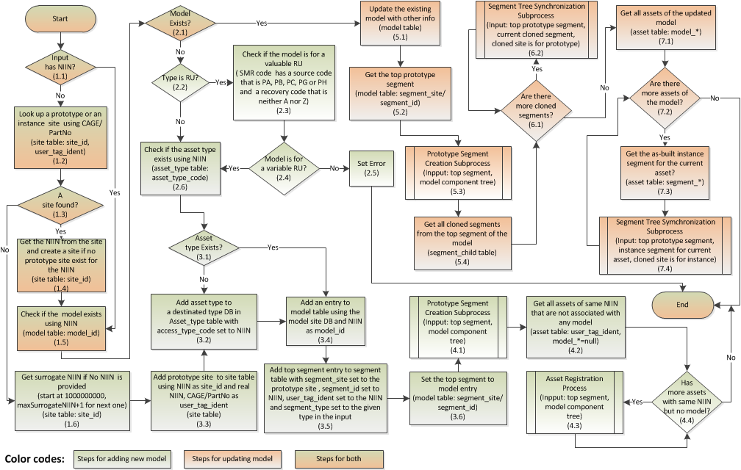
Model Registration Process

Slide 29
Prototype Segment Creation Subprocess
Create new descendent prototype segments for the new subcomponents in a model subcomponent tree and add them to a prototype segment tree
Output:
New descendent prototype segments were added to segment table for all new components in the model subcomponent tree
Existing descendent prototype segments were updated accordingly
Entries in se_network_connect table exist to define the component relationships in the prototype tree
Entries in segment_child table exist to define component inheritance relationships in the prototype tree
Input:
Mandatory: Top segment of a prototype tree
Mandatory :Model subcomponent tree , each component has:
Mandatory: Name,
Conditional:
SMR code,
NIIN or CAGE/PartNo
Prototype Segment Creation Process

Slide 30
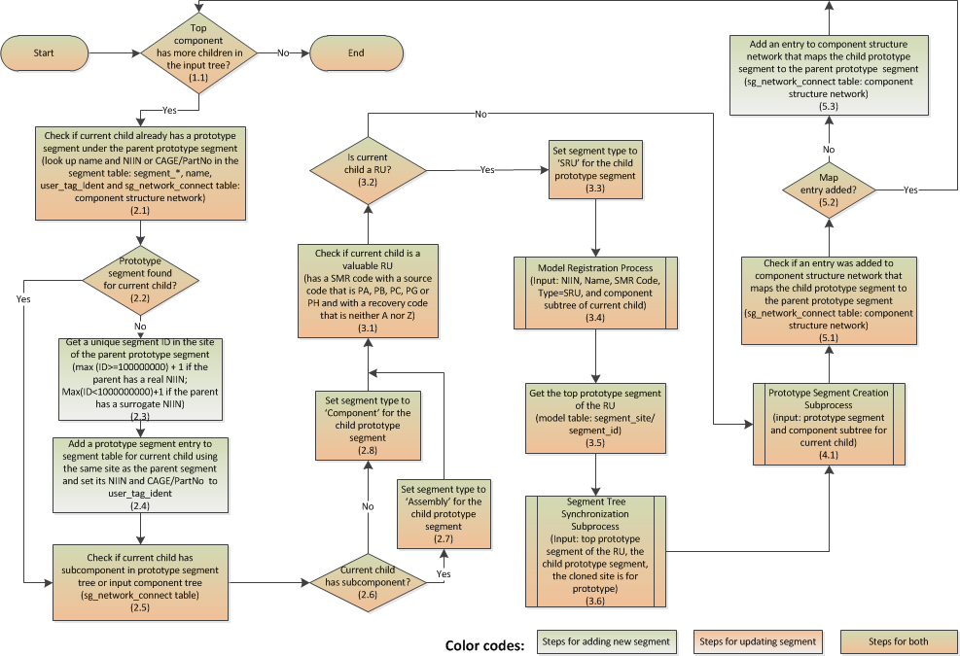
Prototype Segment Creation Subprocess

Slide 31
Segment Tree Synchronization Subprocess
Synchronize a cloned segment tree (either instance or prototype) with a given prototype segment tree
Input:
Mandatory: Top segment of the prototype segment tree
Mandatory: Top segment of a cloned segment tree to be synchronized with the prototype tree
Mandatory: Cloned site is a prototype or instance site
Output:
The cloned segment tree matches the given prototype segment tree
Segment Tree Synchronization Subprocess

Slide 32
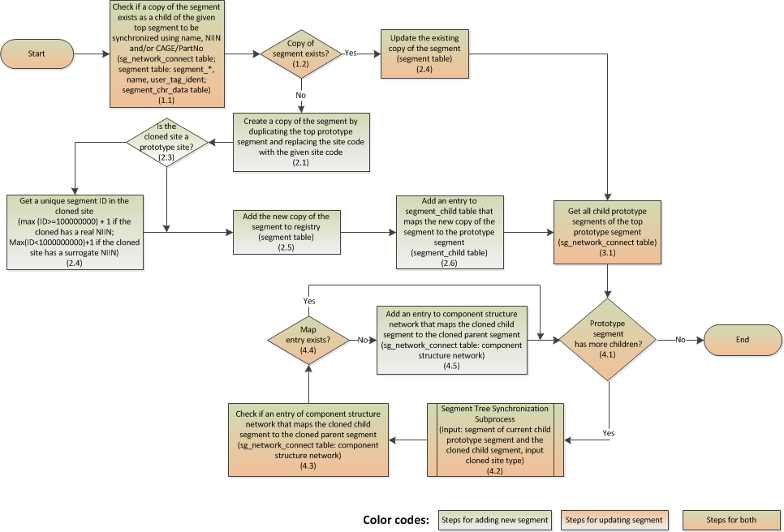
Segment Tree Synchronization Subprocess

Slide 33
Prototype Measurement Configuration Process
Add/update prototype measurement locations of a model
Synchronize the instance measurement locations for all existing assets of the model with the updated prototype measurement locations
Synchronize the cloned measurement configuration for all ascendant models with the measurement configuration of the model
Input:
Mandatory: Model NIIN
Mandatory: List of measurement locations, each of the locations includes:
Mandatory: name, type(Data event group, DA, DM, SD, HA, PA, AG)
Mandatory: segment or asset indicator, monitored segment
Conditional: engineering unit (for CBM layers), update interval (for DA)
Conditional (for CBM layers): alarm info (e.g. alarm type, min, max, typical, effective data, etc.)
Optional: data source type
Output:
New or updated prototype measurement locations exist in the meas_location table for the model
New or updated alarm entries exist for each measurement locations of CBM layer in the num_alarm_reg table
The cloned measurement locations for all existing ascendant models are in sync with the measurement locations of the model
The instance measurement locations for all existing assets of the model are in sync with the measurement locations of the model
Prototype Measurement Configuration Process

Slide 34
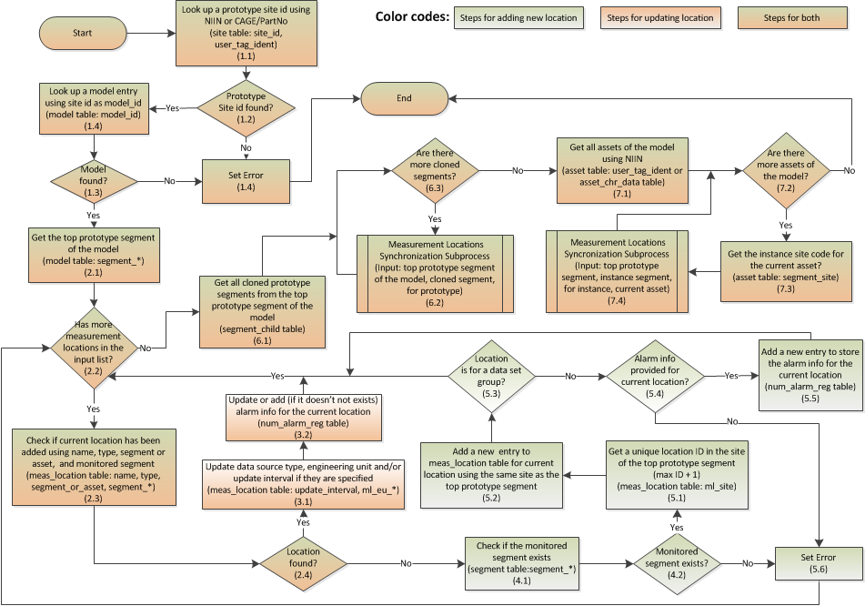
Prototype Measurement Configuration Process

Slide 35
Measurement Location Synchronization Subprocess
Synchronize the measurement locations on an instance or a prototype segment tree with the measurement locations on a prototype segment tree
Output:
The measurement locations on the cloned segment tree matches the measurement locations on the prototype segment tree
If the option is ‘for prototype’: the alarm entries for the measurement locations on the cloned segment tree matches the alarm entries for the measurement locations on the prototype segment tree
Input:
Mandatory: Top segment of the prototype segment tree
Mandatory: Top segment of a cloned segment tree on which the measurement locations to be synchronized with the measurement locations on the prototype tree
Option: ‘for instance’ , ‘for prototype’
Conditional: asset (for instance)
Measurement Location Synchronization Subprocess

Slide 36
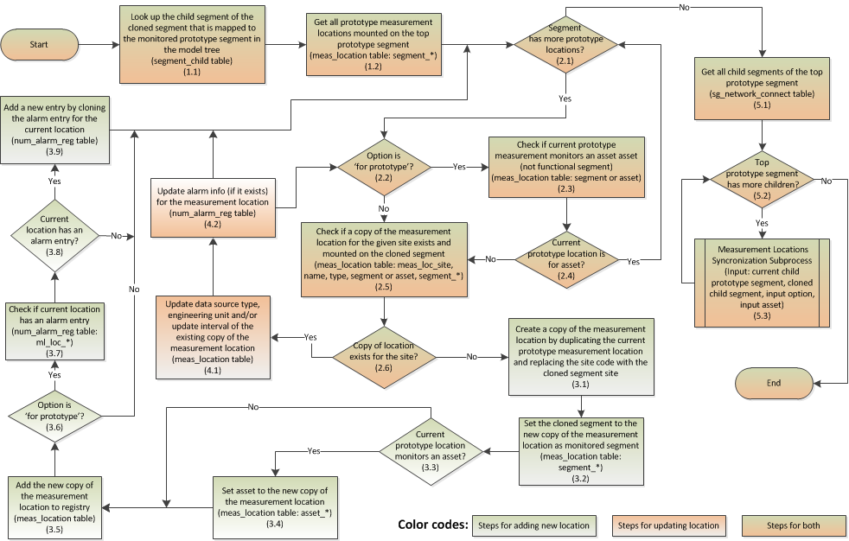
Measurement Location Synchronization Subprocess

Slide 37
Asset Registration Process
Add/update an asset
Synchronize the instance segment tree and measurement configuration of an asset with its prototype segment tree and measurement configuration
Output:
A site for the asset exists in the site table
A asset type for the asset exists in the asset_type table
New or updated asset exist in the asset table
New or updated instance segments exist in the segment table for an asset that has a model in the registry
Entries in the se_network_connect table exist to define the component relationships in the instance segments
Entries in the segment_child table exist to define component inheritance relationships in the instance segments
Input:
Mandatory:
NIIN or CAGE/PartNo
Asset ID: SN/VIN/Other IDs
MACOM
Conditional: Name (for new asset)
Optional: other info
Asset Registration Process

Slide 38
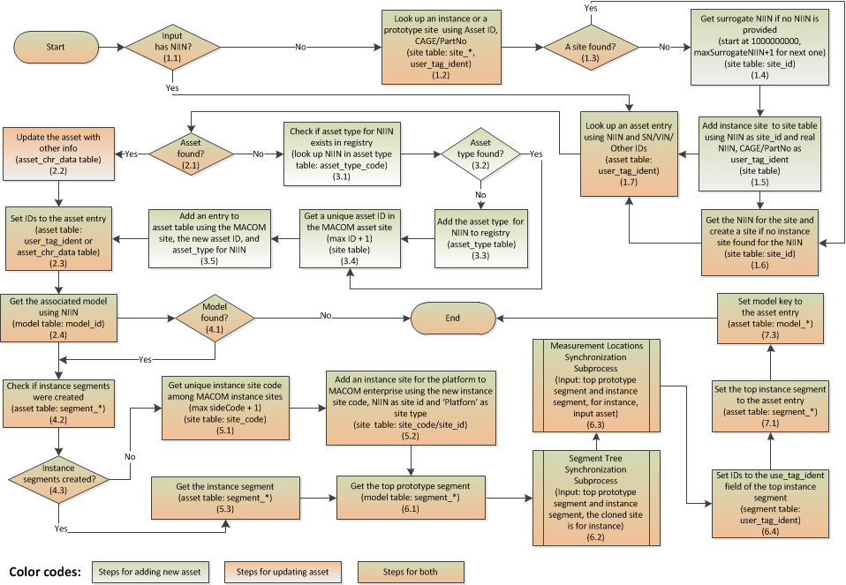
Asset Registration Process

Slide 39
Replaceable Unit Installation Process
Install or replace an RU on a target segment of a parent asset
Associate all sub-RUs to corresponding subsegments of the parent asset segment tree
Associate all corresponding subsegments in the instance segment trees of all ascendant assets to the RU
Output:
An entry in the asset_on_segment table exists to define the installation relationship between the RU and the target segment
Entries in the asset_on_segment table exist to define the installation relationships between the RU and its corresponding sub-segment in the parent asset segment tree
Entries in the asset_on_segment table exist to define the installation relationships between a sub-RU of the RU and a corresponding subsegment in an instance segment tree of a ascendant asset.
Input:
Mandatory RU ID:
NIIN or CAGE/PartNo
Asset ID: SN/VIN/Other IDs
Mandatory: Target segment of the parent assent
Replaceable Unit Installation Process

Slide 40
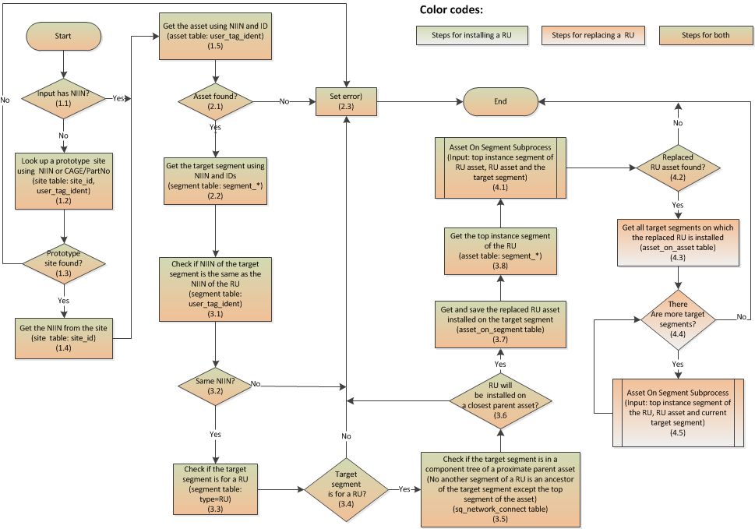
Replaceable Unit Installation Process

Slide 41
Asset On Segment Subprocess
If an RU asset is provided, associate the RU asset with the target segment
Associate all sub-Rus installed on subsegments of a source segment, if any, to corresponding subsegments of a target segment.
Output:
If an RU asset is provided, an entry exists in the asset_on_segment table to define the installation relationship between the RU asset and the target segment
Entries exist in the asset_on_segment table to define the installation relationships between a sub-RU assets of the source segment and its corresponding sub-segment of the target segment
Input:
Source segment
Target segment
RU asset to be installed on the target segment(optional)
Asset On Segment Subprocess

Slide 42
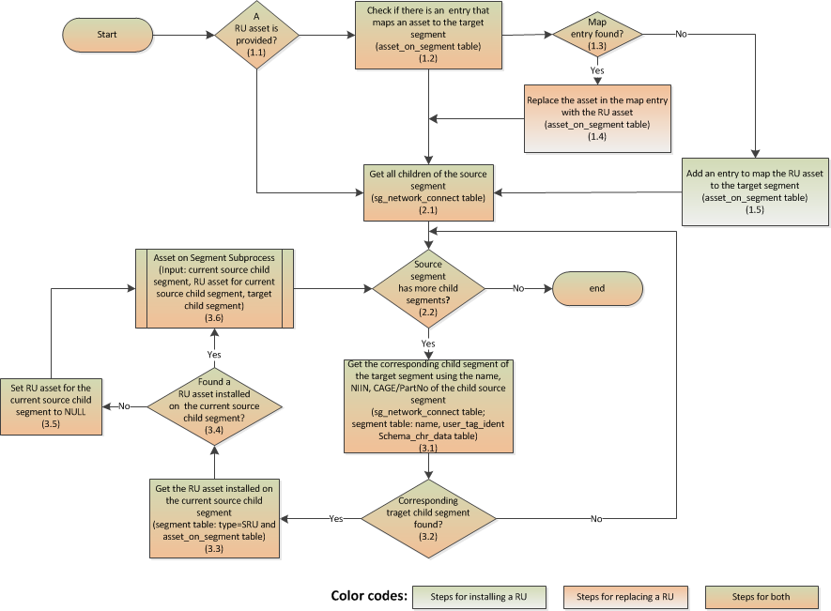
Asset On Segment Subprocess

